Slide 1
MISSIONS IS DONE with the feet of those who go, the knees of those who stay and pray, and the hands of those who give
Cancun World Congress
June, 2013

Slide 2
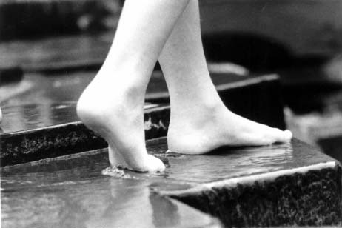
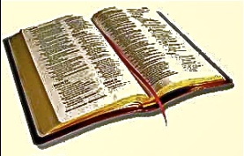
BEAUTIFUL FEET “With the feet of those who go…”
Often times we have as an excuse to not send more missionaries, that we don’t have the money.
There is not a shortage of money to do missions
There is a shortage of workers
Jesus tells us that in Luke 10:2. He told them,
“The harvest is plentiful, but the workers are few. Ask the Lord of the harvest, therefore, to send out workers into his harvest field.”
And God will answer our prayers!
Cancun World Congress
June 2013

Slide 3
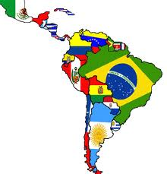
BEAUTIFUL FEET “With the feet of those who go…”
In Latin America God began calling young people many years ago. Some were called in the 1980’s.
And God continues to call.
One of the recent young girls who just left for Africa, is 27 and was called when she was 5 years old in 1992!
And God is calling from Africa, Asia, Europe, and Oceania!
He has been calling for many years.
Cancun World Congress
June 2013

Slide 4
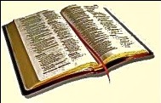
BEAUTIFUL FEET “With the feet of those who go…”
In 1990 when the Iron Curtain fell 40 some countries opened up to the gospel.
The church was slow and not able to respond to the open doors. Today there are many other nations behind the Islamic Curtain.
When it will fall, will the church be ready? With beautiful feet?
Romans 10:14 quotes Isaiah in saying,
“How beautiful are the feet of him who brings good news.”
There is not a shortage of money to do effective missions.
There is a shortage of workers.
Are we praying that God will raise up the workers
we need for the world harvest?
Cancun World Congress
June 2013

Slide 5
BEAUTIFUL FEET “With the feet of those who go…”
TODAY there are between 8,000 and 12,000 missionaries sent out by the Assemblies of God churches.
Internationally Sent: 7,595
Home Missions Cross Culturally Sent: 4.184
Many of those missionaries come from 5-10% of the World Assemblies of God churches.
What would happen if we can get the other 90% involved?
We could easily have over 100,000 workers!
What would happen if every Assemblies of God church prayed for Beautiful knees?
Cancun World Congress
June 2013

Slide 6
BEAUTIFUL FEET “With the feet of those who go…”
IN THE World Assemblies of God
There are 360,000 Churches and Preaching Points
There are 7,595 workers sent out internationally.
That is 1 per every 34 churches. (47 including satellites)
IN FINLAND
They send out one missionary for every 1.57 churches
IN THE UNITED STATES
They have one missionary for every 5 churches. (4.66 to be exact)
IN Argentina
They have one missionary for every 10 churches. (every 6 churches if you don’t include annex/satellite churches).
Cancun World Congress
June 2013

Slide 7
BEAUTIFUL FEET “With the feet of those who go…”
IF IN THE World A/G we could send out
1 missionary for even every 10 churches, there would be 36,000 workers!
IF THE WORLD A/G could do
1 for every 5 churches, they would have 72,000 workers!
And if they could do like the Fins, they would have 240,000 workers!
So in the WORLD ASSEMBLIES OF GOD FELLOWSHIP we have the potential for:
We would have between 36,000 and 240,000 workers!
100,000 workers is possible!
There is a solution other than just praying for workers. It is in raising up as well beautiful knees and beautiful hands, churches with missionary vision to touch the world.
Cancun World Congress
June 2013

Slide 8
BEAUTIFUL FEET “With the feet of those who go…”
In the parable of the 11th hour harvest, the harvest master asks workers who were standing around, “Why are you standing here.” They replied, “no one has hired us.”
We must have a Nike Theology of missions
We can not have excuses for a shortage of workers
Cancun World Congress
June 2013

Slide 9
BEAUTIFUL FEET “With the feet of those who go…”
There is not a shortage of workers
They are in our churches and seated in our services.
We must pray for them to be called, and release them to go, and send them with our knees and hands.
The church must respond to the need of the shortage of workers.
Lord, open our eyes and give us a missionary vision, so that there will not be a shortage of workers!
Cancun World Congress
June 2013

