Slide 1
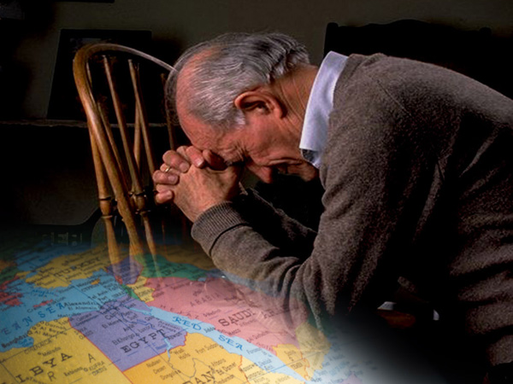
KNEE
WARRIORS
Building Missions Effectiveness Through Prayer
By Paul Brannan

Slide 2
PRAYER IS THE FORGOTTEN WEAPON IN MISSIONS
The weapons we fight with are not the weapons of the world. On the contrary, they have divine power to demolish strongholds. 2 Cor 10:4 NIV

Slide 3
PAUL KNEW THAT PRAYER IS HARD WORK
In the same way, prayer is essential in this ongoing warfare. Pray hard and long. Pray for your brothers and sisters. Keep your eyes open. Keep each other's spirits up so that no one falls behind or drops out. Eph 6:18 THE MESSAGE

Slide 4
PAUL KNEW THE VALUE OF PRAYER
Pray for me, too, and ask God to give me the right words as I boldly tell others about the Lord and as I explain to them that his salvation is for the Gentiles too. Eph 6:19 TLB

Slide 5
AND HE KNEW HOW MUCH HE NEEDED THE PRAYERS OF HIS PARTNERS AT HOME
Don't forget to pray for us too, that God will give us many chances to preach the Good News of Christ for which I am here in jail. Pray that I will be bold enough to tell it freely and fully and make it plain, as, of course, I should. Col 4:3 TLB

Slide 6
PRAYER WILL RESULT IN MORE WORKERS
It will send out workers who are God called workers.
It will train them in God’s school of the Holy Spirit.
It will send them to the right fields.
It will sustain them when they go.

Slide 7
PRAYER WILL SUPPLY THE NEEDED FINANCE
God can reach the checkbooks that we cannot.
The Holy Spirit can call thousands of believers and bless them beyond measure, using their abilities to earn the finances to support missions.
Through prayer God can and will call many to become Senders.

Slide 8
PRAYER WILL REMOVE THE DIFFICULTIES
Open countries closed to the gospel.
Enter the offices of kings and presidents.
Change the course of wars and uprisings.
Protect the missionaries from sickness and danger.
Remove the loneliness and homesickness from the heart of the missionaries.

Slide 9
PRAYER WILL BREAK DOWN BARRIERS
Remove prejudice against the gospel and the missionary.
Wipe away spiritual blindness from the eyes of millions.
Bring spiritual awakening that will shake whole nations.
THE BATTLE WILL ONLY BE WON THROUGH PRAYER

Slide 10
HOW CAN WE ENCOURAGE PRAYER FOR MISSIONS?
Include missions prayer needs in the weekly bulletin and/or publish a monthly missions prayer page.
Conduct a frequent 5 to 10 minute intercessory prayer time during a regular service

Slide 11
WE CAN ALSO…
Form missions prayer groups for each area of the world
Distribute to the congregation special literature that encourages prayer for missions.

Slide 12
HOW CAN WE PREPARE FOR MORE EFFECTIVE PRAYER?
Know your missionaries and pray for them regularly
Print their names in the bulletin or read them from the pulpit and pray for them on a rotating basis.
Place their pictures on a loop and project them prior to the service or at prayer time.

Slide 13
YOU MAY ALSO:
Secure a list from your national missions department with birth dates, etc. of each family member
Use the prayer requests provided by the national office and missionary newsletters.
Use books that focus on world need, such as Operation World, (Johnstone – Zondervan).

Slide 14
HOW CAN WE PRAY MORE EFFECTIVELY?
Be specific – Name the missionary, need, country or project.
Ask God to call more workers to go.
Ask God to call more senders.
Intercede for countries where there are few or no missionaries present.

Slide 15
WHEN WE PRAY FOR THE MISSIONARIES, WE SHOULD INCLUDE:
Anointing, wisdom and favor
Health, strength and protection
Financial supply
Children’s education

Slide 16
WE SHOULD ALSO INCLUDE:
Care and provision when family members are separated
Family’s spiritual welfare
Bind demonic oppression
The success of their assigned ministry on the field

Slide 17
BE PERSISTENT IN YOUR PRAYERS
Don't be weary in prayer; keep at it; watch for God's answers… Col 4:2 TLB

Slide 18
AND REJOICE FOR THE ANSWER
… and remember to be thankful when (the answers) come. Col 4:2 TLB

