Slide 1
MISSIONS IS DONE with the feet of those who go, the knees of those who stay and pray, and the hands of those who give
Cancun World Missions Congress
June, 2013

Slide 2
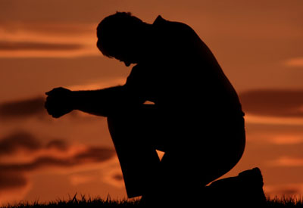
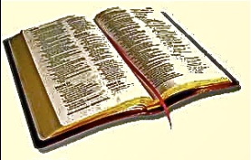
BEAUTIFUL KNEES “The knees of those who stay and pray…”
Ezekiel 22:30
"I looked for a man among them who would build up the wall and stand before me in the gap on behalf of the land so I would not have to destroy it, but I found none.”
THERE IS A SHORTAGE OF INTERCESSORS!
Romans 10 talks about beautiful feet. But Romans 10:14 also says, “And how can they go, unless they are sent?”
We don’t just need beautiful feet to do missions, we need senders. We need beautiful knees and beautiful hands to send the beautiful feet.
Cancun World Congress
June 2013

Slide 3
BEAUTIFUL KNEES “The knees of those who stay and pray…”
The sending church is a church that prays for missions, and prays for the world.
I have met many people who give of missions offerings that don’t pray
I have never met someone who prays that doesn’t give
If it is important enough for us to pray for, it will also be important enough for us to give too.
Cancun World Congress
June 2013

Slide 4
BEAUTIFUL KNEES “The knees of those who stay and pray…”
If there are 65 million believers in the world assemblies of God fellowship, surely we can see 5 million intercessors raised up?
But how exciting it would be to have 130 million ‘beautiful knees.”
The Assemblies of God wants to plant 150,000 new churches by 2020.
They want to grow to 100 million believers.
We can not do it without prayer and intercession.
Cancun World Congress
June 2013

Slide 5
BEAUTIFUL KNEES “The knees of those who stay and pray…”
We need not just people who pray, but people who intercede.
Prayer can often times focus on my own relationship with God, and my own needs
My family My home My city My church My country
Intercession focuses on others, on those whom we have no personal connection or interest in.
We need not just people who pray, but people who intercede.
Cancun World Congress
June 2013

Slide 6
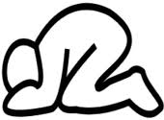
BEAUTIFUL KNEES “The knees of those who stay and pray…”
If the World Assemblies of God doesn’t many people giving missions offerings for the world, it is also likely they don’t have many people interceding for the unreached nations in the world.
Because if we give of our money, we will also give of our time. It is important not just to raise up beautiful hands, but also beautiful knees.
We can not reach the world with men and women and money.
We must have beautiful knees
Cancun World Congres
June 2013

Slide 7
BEAUTIFUL KNEES “The knees of those who stay and pray…”
Beautiful knees remind us of our dependency on God.
It reminds us that we are weak but He is strong. That we are unable, but He is able!
That we can’t do it by ourselves, but with him we can do all things through Him who gives us strength!
They give us humility, compassion, and a burden for the world.
Cancun World Congress
June 2013

Slide 8
BEAUTIFUL KNEES “The knees of those who stay and pray…”
If there are 65 million believers in the World Assemblies of God surely we can have 5 million intercessors?
And even more who pray for missions and the world?
If every believer in the WAGF gave us 1 hour a month to intercede for the world,
which is 2 minutes a day, we would have
Almost 4 Billion minutes each month of intercession
Almost 48 Billion minutes a year
Cancun World Congress
June 2013

Slide 9
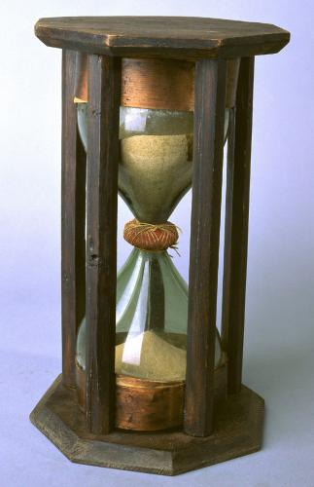
BEAUTIFUL KNEES “The knees of those who stay and pray…”
If every believer in the World Assemblies of God
prayed 5 minutes a day,
we would have almost 10 billion minutes
each month of intercession!
If they gave an hour a week,
we would have nearly 200 billion minutes a year!
More than 28 times the population of the world!
Cancun World Congress
June 2013

Slide 10
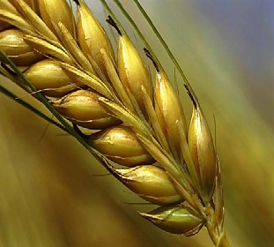
BEAUTIFUL KNEES “The knees of those who stay and pray…”
There is a shortage of workers the Bible tells us.
There is also a shortage of intercessors, of people who stand in the gap.
May the Lord be able to say, “I looked in the Assemblies of God churches of the world, and I found many to stand in the gap.”
Lord, raise up many
intercessors for the harvest
fields of the world!
Cancun World Congress
June 2013

